Slide 1
CHAPTER 4
DISCRETE SYSTEM SIMULATION
4. Discrete System Simulation (8 hrs)
4.1 Discrete system simulation
4.2 Representation of time
4.3 Generation of arrival patterns
4.4 Simulation of telephone system
4.5 Gathering statistics
4.6 Counters and summary statistics
4.7 Measuring Utilization and Occupancy
4.8 Recording distribution and transit time
4.9 Discrete simulation languages

Slide 2
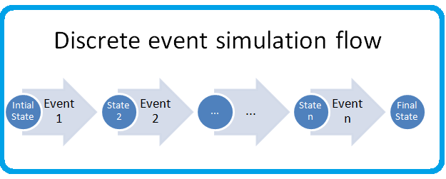
DISCRETE SYSTEM SIMULATION
Discrete Events
A simulation process will take the system model through a series of states.
We can describe the state of a system at a given instant, since the model of a system has a set of numbers to represent the state of a system.

Slide 3
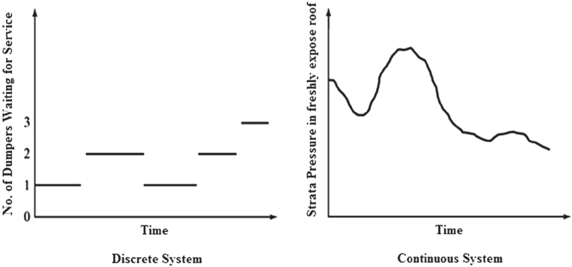
Discrete Events
A number that is used to represent some aspect of some system states is called a state descriptor.
As the simulation proceeds, the state descriptor changes their values.
Discrete event can be defined as a set of circumstances that cause an instantaneous change in one or more state descriptors of the system.

Slide 4
Discrete Events
Discrete event simulation concerns the modelling of the system as it evolves over time by a representation in which state variable changes instantaneously or at separate points in time.
It is also necessary that changes must be made sequentially.
So, a system simulation must contain a number representing time.
The simulation proceeds by executing all the changes to the system descriptors associated with each event, as the event occurs in chronological order.

Slide 5
Representation of Time
It refers to numbers that record the passage of time.
It is usually set to zero at the beginning of a simulation and subsequently indicates how many units of simulated time have passed since the beginning of the simulation.

Slide 6
Simulation Time / Time Advance Mechanism
Discrete event simulation concerns the modelling of the system as it evolves over time by a representation in which state variable changes instantaneously at separate points in time.
These points in time are the ones at which an event occurs. Event is an instantaneous occurrence that may change the state of the system.
It is necessary to keep track of the current value of the simulated time as the simulation proceeds and also we need a mechanism to advance simulated time from one value to another.

Slide 7
Simulation Time / Time Advance Mechanism
This is represented through simulation clock.
Simulation clock refers to the integrated clock time. Note that it is not the time that the computer has taken to carry out the simulation.
The simulation clock helps represent the dynamics of a system as if it were happening in real life, regardless of how fast or slow the computer calculates it. It's a vital abstraction in simulation to keep events in proper sequence and timing.

Slide 8
Simulation Time / Time Advance Mechanism
There are two basic methods used to update clock time:
i) Event Oriented Method [Next Time Advance Mechanism]
ii) Interval Oriented Method [Fixed Time Advance Mechanism]

Slide 9
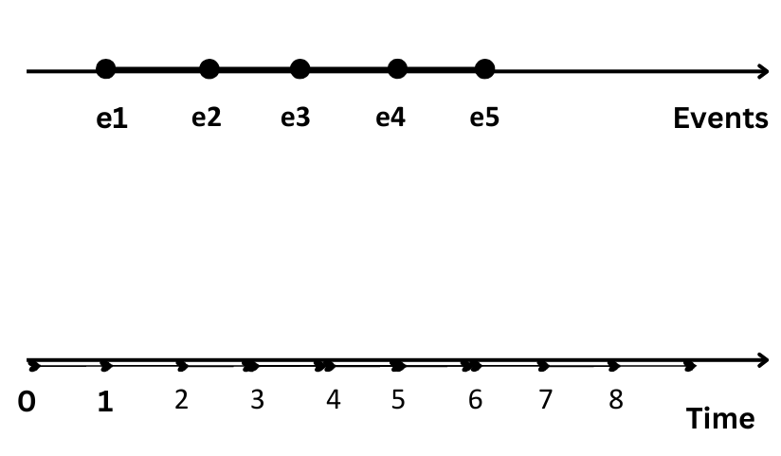
Simulation Time / Time Advance Mechanism
i) Event Oriented Method [Next Time Advance Mechanism]
In this method, the clock is advanced to the time at which the next event likely occurs.
In the above figure, we see that events e1, e2, e3, e4 occur at times 1, 2, 4, and 6 time units respectively.

Slide 10
Simulation Time / Time Advance Mechanism
With the next time advance mechanism, the simulation clock is initialized at zero initially.
A simulation clock is then advanced to the time of near-happening events at which point the state of the system is updated.
Clocks jump from one event time to the next and doesn't exist for time between successive events.
Discrete system simulation is usually carried out by using the event-oriented method.

Slide 11
Simulation Time / Time Advance Mechanism
ii) Interval Oriented Method [Fixed Time Advance Mechanism]
In this method, the clock is advanced by small uniform intervals of time and determines at each interval whether an event is due to occur at that time.
e0 e1 e2 e3 e4 e5
0 - 1 - 2 - 3 - 4 - 5 - 6 - 7 - 8 - 9 - 10 (Time)
In the above figure, we see that events e1, e2, e3, e4 occur at times 0, 2, 4, 6, 8, and 10 time units respectively.

Slide 12
Interval Oriented Method [Fixed Time Advance Mechanism]
With a fixed-time interval mechanism, the simulation clock is incremented with a small interval Δt (here 2), whether the event is occurred or not, we look at events at Δt to update the state of the system.
It is a very simple method to implement but not an accurate realization of occurrence of events.
Continuous system simulation normally uses the interval-oriented method.

Slide 13
An event-oriented program will detect discrete changes and can therefore simulate a discrete system.
An interval-oriented program can follow continuous changes by artificially introducing events that occur at regular time intervals and can therefore simulate a continuous system.

Slide 14
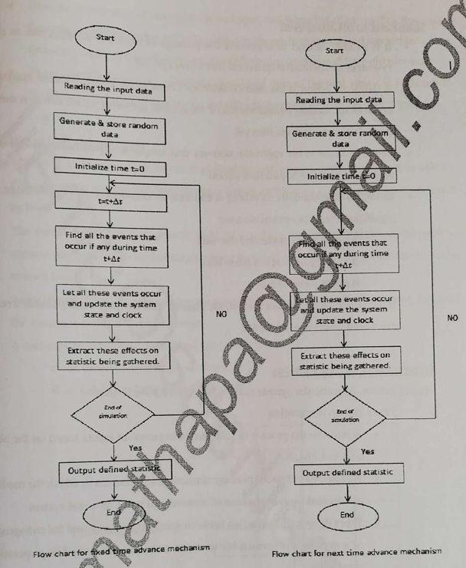

Slide 15
An event oriented program will detect discrete changes and can therefore simulate discrete system.
An interval oriented program can be made to follow continious changes by artificially introducing events that occours at regular time interval and can therefore simulate continious system.

Slide 16
Significant Event Simulation
It is another method to represent the passage of time and is applicable to continuous systems in which there is a quiescent (not active) period.
A quiescent period is the interval between events in the event-oriented approach, but it involves the models' representation of the system activities, which create a notice of the event that terminates the interval.
The significant event approach assumes that a simple analytic function can be used to project the value of a quiescent period.

Slide 17
Significant Event Simulation....cont..
Example: An automobile traveling at constant acceleration might result in a significant event for several reasons:
It might reach the end of the road.
Its velocity might reach some limit.
It might come to rest.
If the initial conditions are known, the elapsed time for each of these possible events can be calculated from a simple formula.

Slide 18
Generation of Arrival Patterns Arrival pattern for a particular system must be specified for simulation.
i. Trace Driven Simulation
It refers to the process of gathering a sequence of inputs based on the observation of a real system.
It is an important tool in many simulation applications where the model’s inputs are derived from observations made on a real system.
When there is no interaction between exogenous arrivals and endogenous events of a system, it is permissible to create a sequence of arrivals in preparation for the simulation.
Usually, the simulation proceeds by creating new arrivals as they are needed.

Slide 19
Trace Driven Simulation...Cont..
Trace Driven Simulation involves using pre-recorded data (a "trace") from a real-world system to simulate the behavior of a system or model.
It helps study how a system reacts to real-world inputs and provides insights without needing to test on the actual system.
A sequence of inputs or events from a real system (trace) is fed into the simulation model. The model then behaves as though those inputs occurred in real time.

Slide 20
Trace Driven Simulation Example:
Imagine a network server that handles client requests.
You first observe the server for a day and record the arrival times of requests and their sizes (this is your trace).
You use this trace data to simulate the server in a lab to test how it would perform under different conditions, like a faster or slower processor.
This avoids the need to experiment on the live server, reducing the risk of disruption.

Slide 21
Bootstrapping
Bootstrapping usually refers to a self-starting process that is supposed to proceed without external input.
It is the process of making one entity create its successor.
Here, the arrival time of the next entity is recorded, and when the clock reaches this event time, the event of entering the entity into the system is executed.
The arrival of the following entity is immediately calculated from the inter-arrival time distribution.
These methods require keeping only the arrival time of the next entity. It is, therefore, the preferred method of generating arrivals for computer simulation programs.

Slide 22
Bootstrapping....cont..
Bootstrapping refers to a self-starting process where the system generates new events or arrivals based on its own rules without relying on external inputs.
It is useful for initializing or running a system where external input isn’t immediately available.
Each entity (like a task or an event) creates its successor. For example, the system generates the time for the next event based on probabilities or a pre-defined distribution.

Slide 23
Bootstrapping...cont.. Example:
Consider a restaurant simulation where customers arrive at random intervals.
Instead of observing actual arrival times (like in Trace Driven Simulation), you program the simulation to create arrivals using a random distribution (e.g., exponential distribution for inter-arrival times).
When one customer arrives, the system calculates when the next customer will arrive, based on the distribution.
This keeps the simulation running without needing real-world data.

Slide 24
Comparison :
Feature | Trace Driven Simulation | Bootstrapping
Input Source | Real-world trace data (observations). | Self-generated using statistical methods.
Use Case | Testing behavior against real-world patterns. | Running a system without real-world inputs.
Example | Simulating network traffic using actual logs. | Simulating random customer arrivals.

Slide 25
Use Trace Driven Simulation when you want to study or reproduce behavior based on observed real-world data.
Use Bootstrapping when no real-world data is available, and you want the system to self-generate new events or arrivals based on rules or distributions.

Slide 26
Simulation of Telephone System
The simulation of a discrete system can be explained by simulating a telephone system as below:

Slide 27
Objectives
Process a given number of calls and determine what proportions are
successfully completed
blocked or
found to be busy calls

Slide 28
Objectives
The system has a number of telephones (8 are shown) connected to a switchboard by lines.
The switchboard has a number of links which can be used to connect any two lines, subject to the condition that only one connection at a time can be made to each line.
The system is lost call system.
i) A call is lost, if the called party is engaged, then it is a busy call.
ii) A call may be lost if no link is available, it is blocked call.

Slide 29
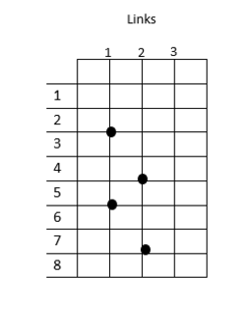

Slide 30
Situation
Each call is a separate entity having attributes
a) Source
b) Destination
c) Length, and
d) the time at which call finished
0 represents Free
1 represents Busy
To keep track of event, a number representing clock time is included. At present 1035(time unit)
To generate the arrival of call, a record is kept of the time the next call is due to arrive.
The set of numbers within the main box of figure records the state of the system at time 1027.
There are two activities causing events:
i) New calls arrive
ii) Existing calls vanish

Slide 31
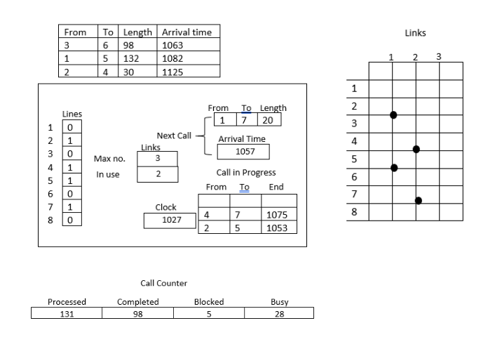

Slide 32
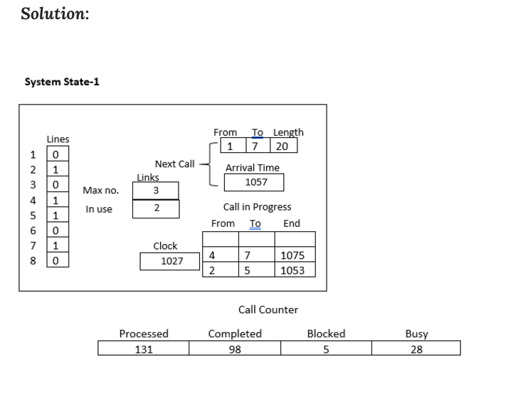

Slide 33
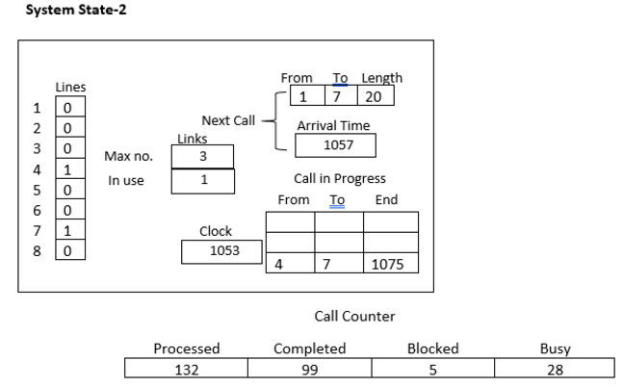

Slide 34
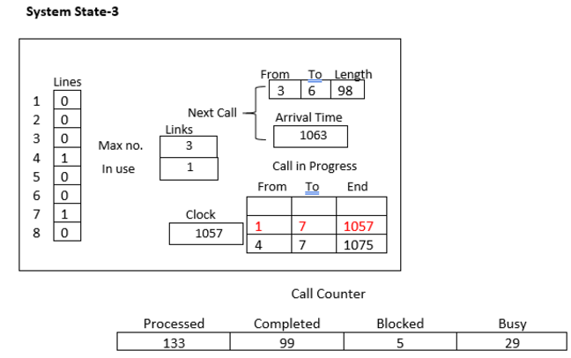

Slide 35
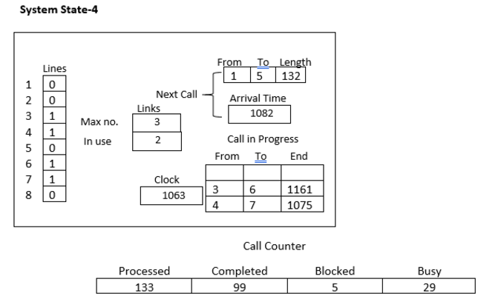

Slide 36
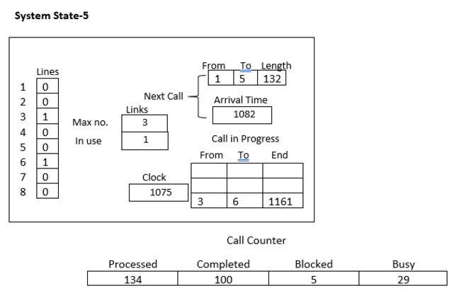

Slide 37
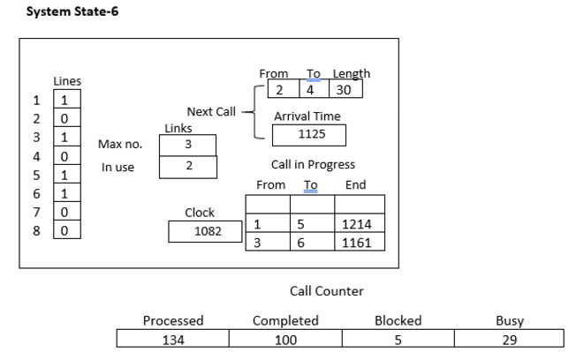

Slide 38
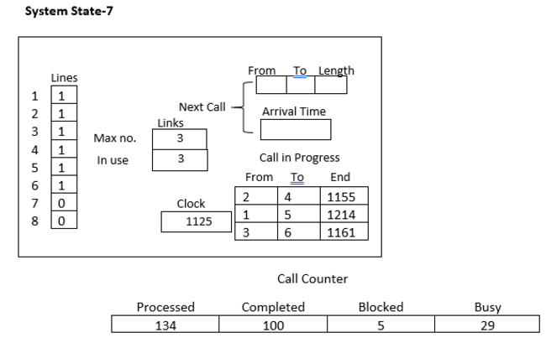

Slide 39
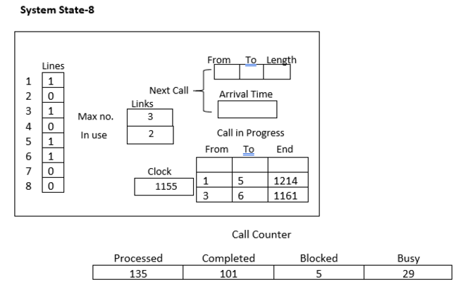

Slide 40
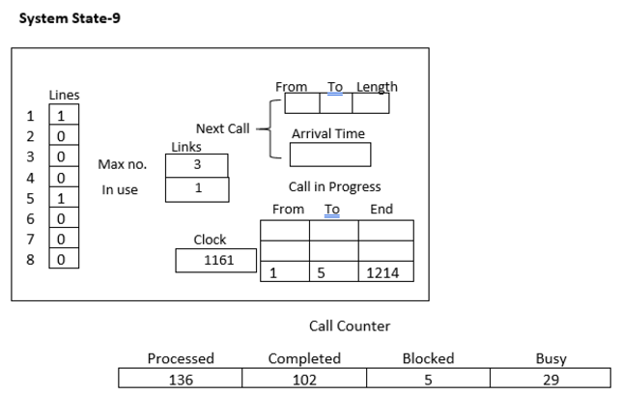

Slide 41
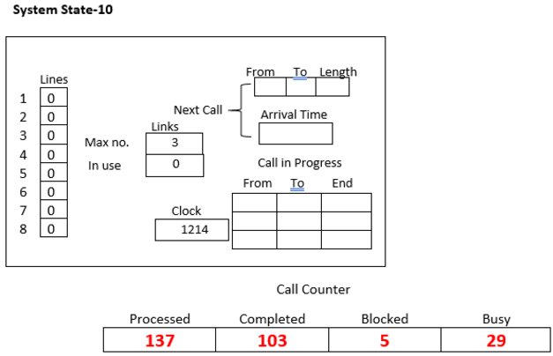

Slide 42
Termination of simulation
After processing a given number of calls, or
Until a certain time has elapsed.

